Slide 1
Exchanging protein function prediction rules with the community
The URML format and UniFIRE engine
Alexandre Renaux Bioinformatics Software Engineer
www.ebi.ac.uk

Slide 2
Predicting the function of protein sequences
Growing number of protein sequences which function is unknown.
Many methods inferring the function from databases of proteins whose functions are known, based on:
Sequence similarity
Protein structure similarity
Protein families & domains
Orthology relations
Genomic context
PPI network
…
Combining methods and criteria
Annotation Rules

Slide 3
Project aims
Annotation rules are valuable knowledge that should be publicly shared
Distributing annotation rules
To open the UniProt systems to the community
To facilitate the exchange of rules between research groups
Providing a way to apply the rules on your data
Standalone tool
Service
Open to contribution
We need your feedback
Open-source code, extensible model, …

Slide 4
The UniProt functional annotation systems

Slide 5
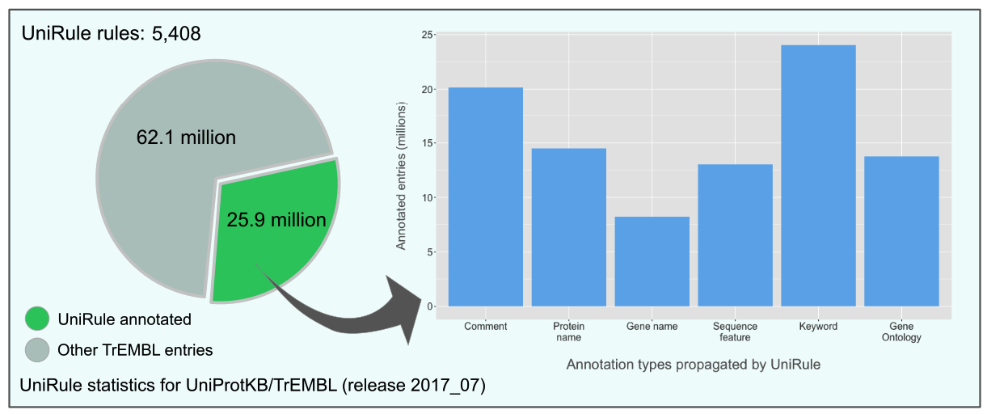
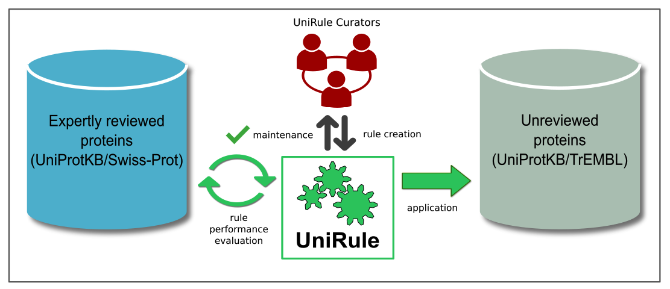
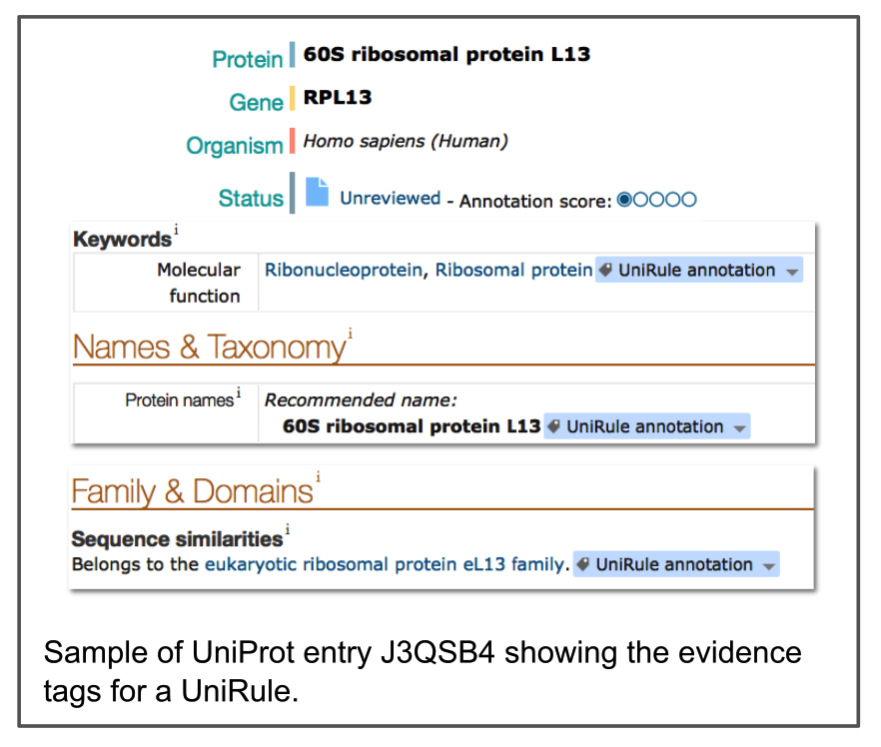
The UniRule System
Use the presence of specific protein signatures together with taxonomy to predict the biochemical features and biological role of a protein
Rules are created and tested by experienced curators using experimental data from manually annotated entries

Slide 6
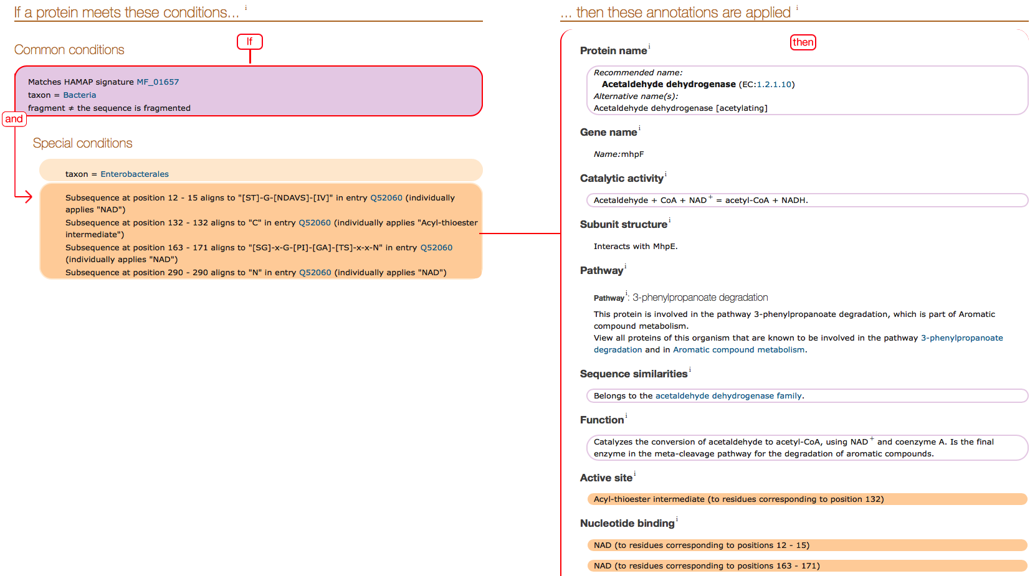
UniRule: more complex example
http://www.uniprot.org/unirule/UR000083169

Slide 7
The Statistical Automatic Annotation System
Generates automatic rules for functional annotation from expertly annotated entries in UniProtKB/Swiss-Prot using the C4.5 decision tree algorithm
Algorithm find the most concise rule for an annotation based on the properties of sequence length, InterPro group membership and taxonomy

Slide 8
SAAS Decision tree learning explained
SwissProt
IPR005478
Eukaryota
PF02780
Transketolase
Prot1
Yes
No
Yes
Yes
Prot2
No
Yes
No
No
Prot3
No
Yes
Yes
No
Prot4
Yes
Yes
No
No
Prot5
Yes
No
Yes
Yes
Prot1, Prot4, Prot2, Prot5, Prot3
+
IPR005478?
-
Prot1, Prot4, Prot5
Prot2, Prot3
Not Transketolase
+
-
PF02780?
Prot1, Prot5
Prot4
Transketolase
Not Transketolase

Slide 9
UniProt rules: conditions & annotations
Conditions
Annotations
InterPro Signatures:
(Super)families
Domains
Repeat
Site
Organism:
Taxonomy
Scientific name
Gene location (organelle)
Sequence:
Length
Is fragmented
Patterns
Protein name
Function
Gene Ontology terms
Catalytic activity
Pathway membership
Subcellular location
Sequence positional features
positions of post-translational modifications
active sites
…

Slide 10
UniRule Taxonomic Constraints
∑ rules for all children:
- Collapse criteria: < 50 rules
- Stop criteria: < 100 rules

Slide 11
SAAS Taxonomic Constraints
∑ rules for all children:
- Collapse criteria: < 50 rules
- Stop criteria: < 100 rules

Slide 12
Sharing UniProt rules with the community

Slide 13
Sharing UniProt rules with the community
Two components:
Exchange format:
Common for UniRule, SAAS, (ARBA, …) rules
Standard: well supported / understood
Exposing all the logic to interpret the rules
Engine:
Able to apply the rules on a set of data
Able to retrieve the inferred annotations

Slide 14
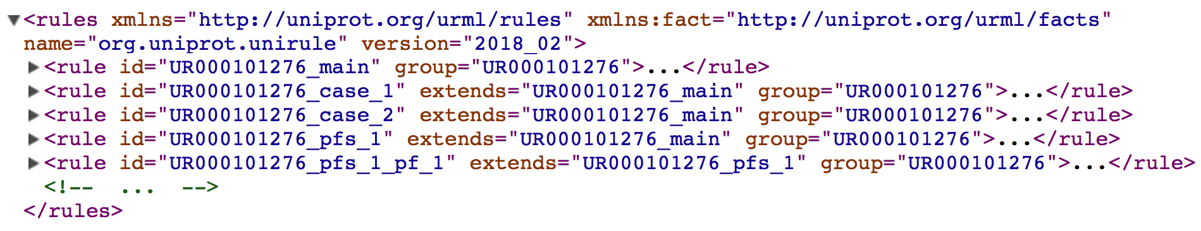
The UniProt Rule Markup Language (URML)
Features:
Based on XML
Rules as the basic logical unit: (conditions → actions)
Linked to a fact model
Explicit condition querying using fact model class/attributes
Annotations in the form of tuples: (type, value)
General structure:
Rule Format schema
Fact Model schema
One UniRule (UR000101276) represented with 5 rules grouped with the same UniRule ID

Slide 15
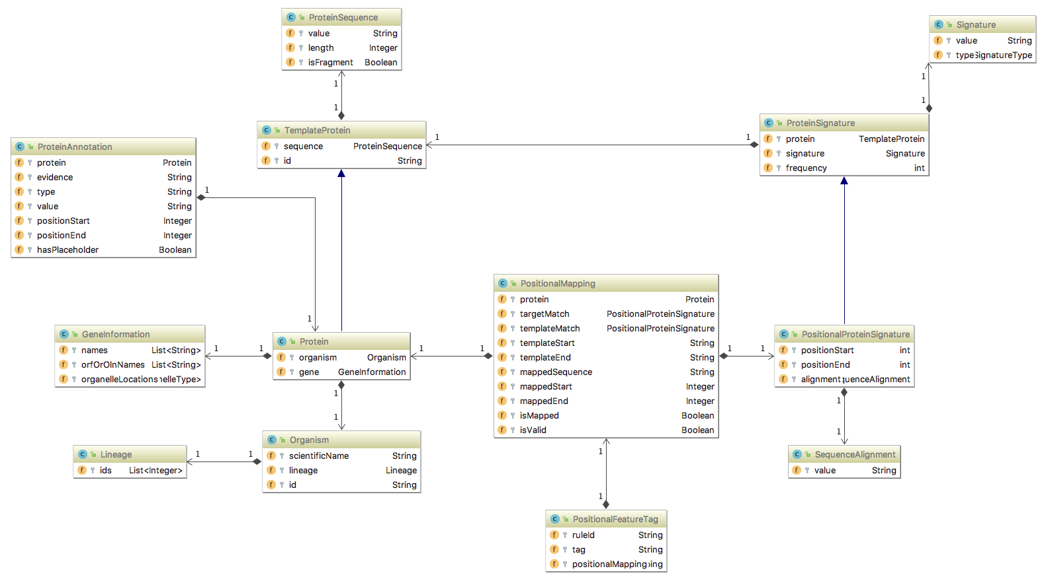
URML: The Fact Model
Positional feature support

Slide 16
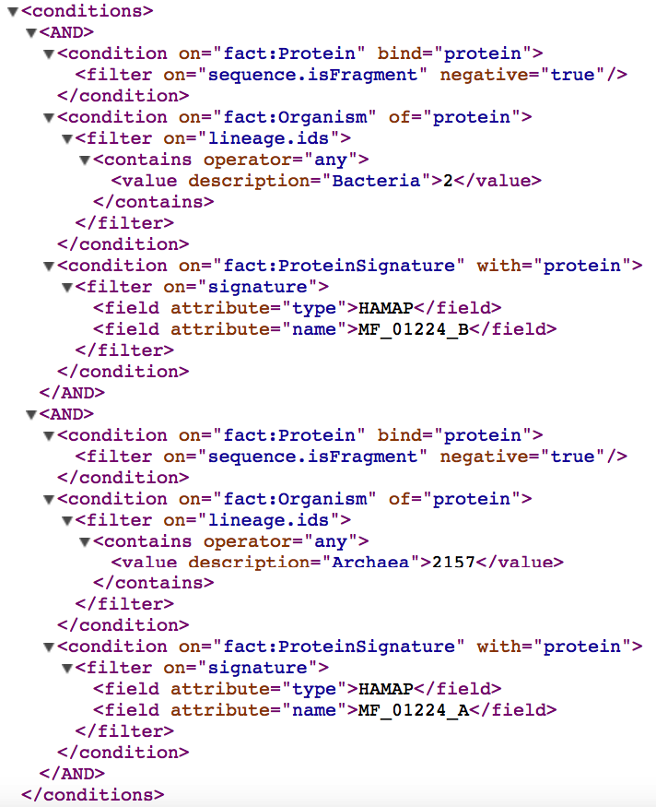
URML: Condition Space
AND block
OR …
If there is a fact Protein (that we call “protein”)
having its attribute “sequence” having its attribute “isFragment” == false
And the Organism of that protein has its attribute “lineage” having its attribute “ids” that contains 2157.
And there is a ProteinSignature with protein having the attribute “signature” having its attributes: “type”=HAMAP and “name”=MF_01224_A
Then …

Slide 17
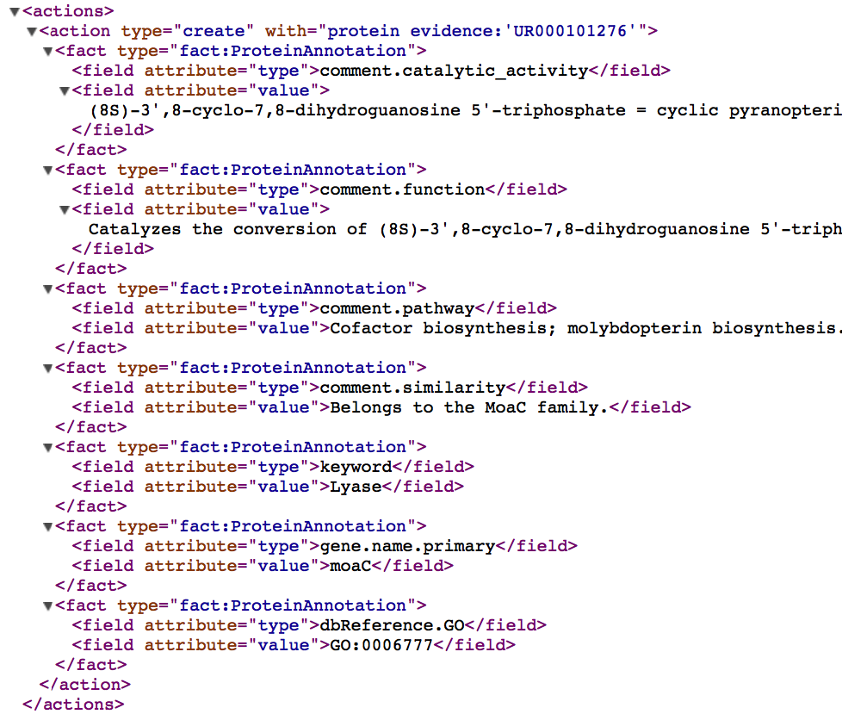
URML: Action Space
Every ProteinAnnotation is bound to its protein and an evidence (rule id)
Create ProteinAnnotation facts, with type and value.

Slide 18
UniFIRE: The UniProt Functional annotation Inference Rule Engine

Slide 19
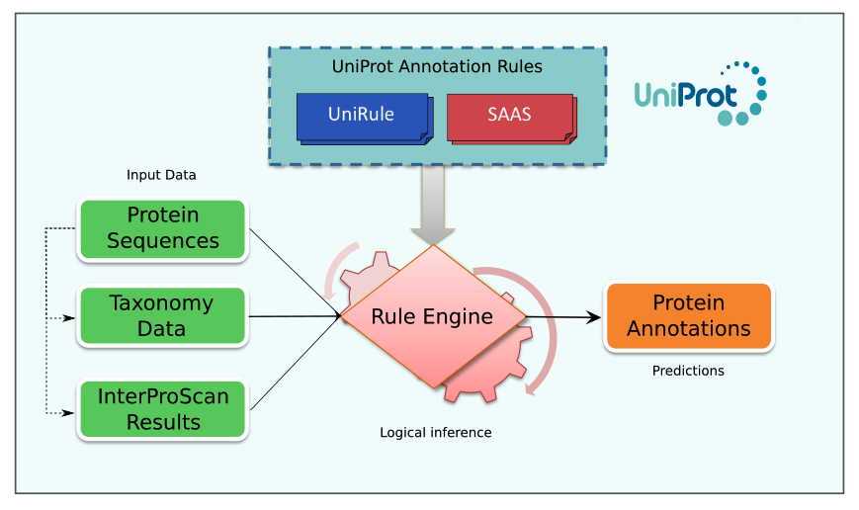
Execution of the UniProt rules

Slide 20
What is a Rule Engine?
Rule
when:
conditions
then:
conclusions
This architecture is a common implementation to design expert systems.

Slide 21

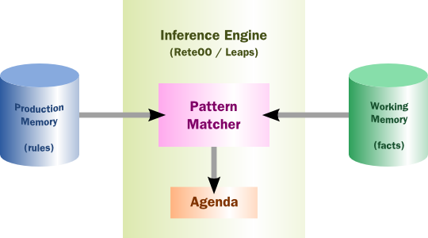
Drools: A Business Rule Management System
A modern and open-source production rule system
Combines rule-based approach and object-oriented programming
Key features:
Optimized pattern matching algorithm to scale
Hybrid reasoning (forward and backward chaining)
Integration with Java environment

Slide 22
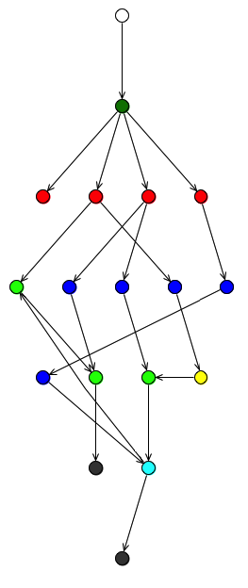
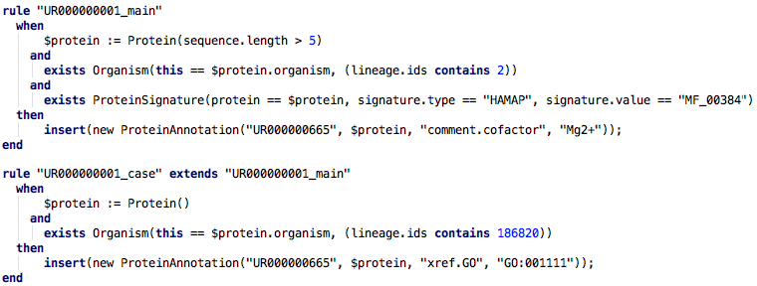
Drools execution explained
Fact Base (WM)
O = Organism(lineage.ids=[2, …,186820])
P = Protein(sequence.value=“MLVIFY”, organism=O)
I = ProteinSignature(protein=P, signature={“HAMAP”, “MF_00384”})
Rule Base
O = Organism(taxonomyIds=[2, …,186820])
P = Protein(sequence=“MLVIFY”, organism=O)
I = ProteinSignature(protein=P, signature={“HAMAP”, “MF_00384”})
ProteinAnnotation(rule=“UR00000001”, protein=P, value=“Mg2+”)
ProteinAnnotation(rule=“UR00000001”, protein=P, value=“GO:001111”)
Fact Base (WM)

Slide 23


Input / Output
Fasta header containing all required metadata.
Input
Sequences
(MultiFasta)
InterProScan
Output
(XML)
Alternative input: using the fact model (XML, database ORM, etc…)
InterProScan
Template
Sequences
(MultiFasta)
UniFIRE
Rule File
(URML)
(For UniRule positional features only)
Annotations (XML / CSV)

Slide 24
Summary
We want to exchange the functional annotation knowledge
We have designed:
A format to exchange annotation rules
An engine to apply them
We would need your feedback and ideas:
On the rule format
On the input / output data
On the engine (beta-testing)

Slide 25
Demo of the UniFIRE alpha-version

Slide 26
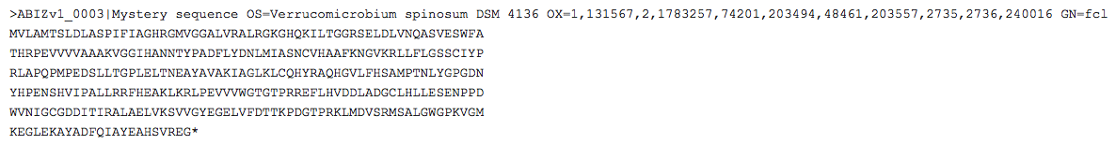
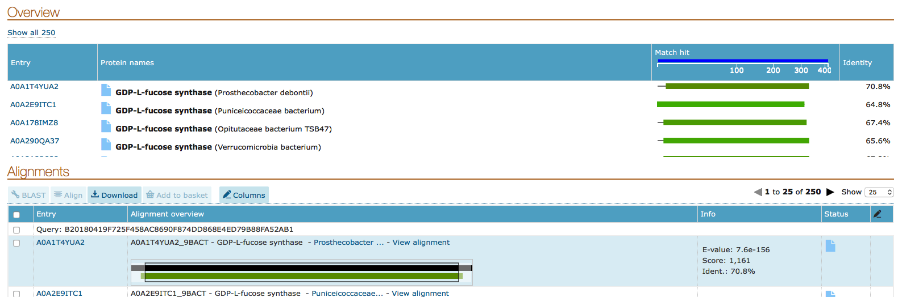
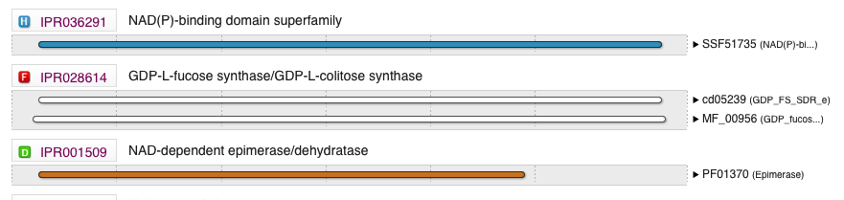
Demo – Input Sequence
Blast search
InterProScan
70% identity not enough to infer annotations by similarity

Slide 27
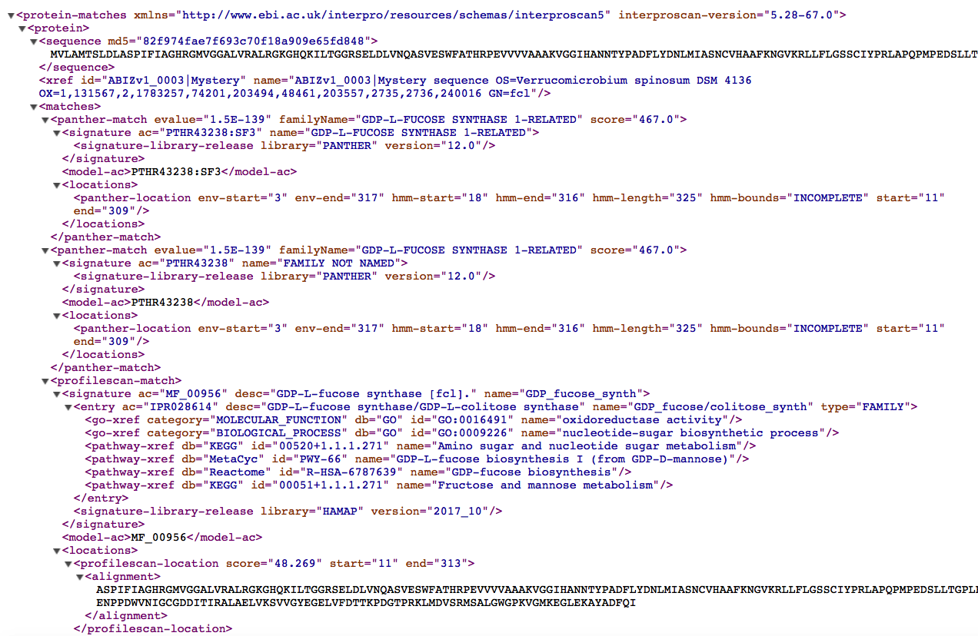
Demo – Running InterProScan
Provided. For UniRule only.
interproscan-output.xml

Slide 28
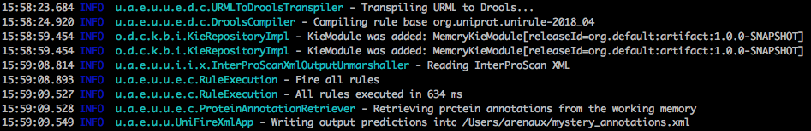
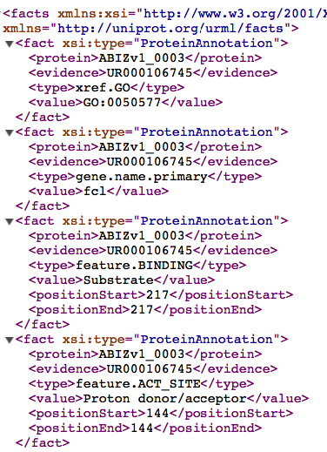
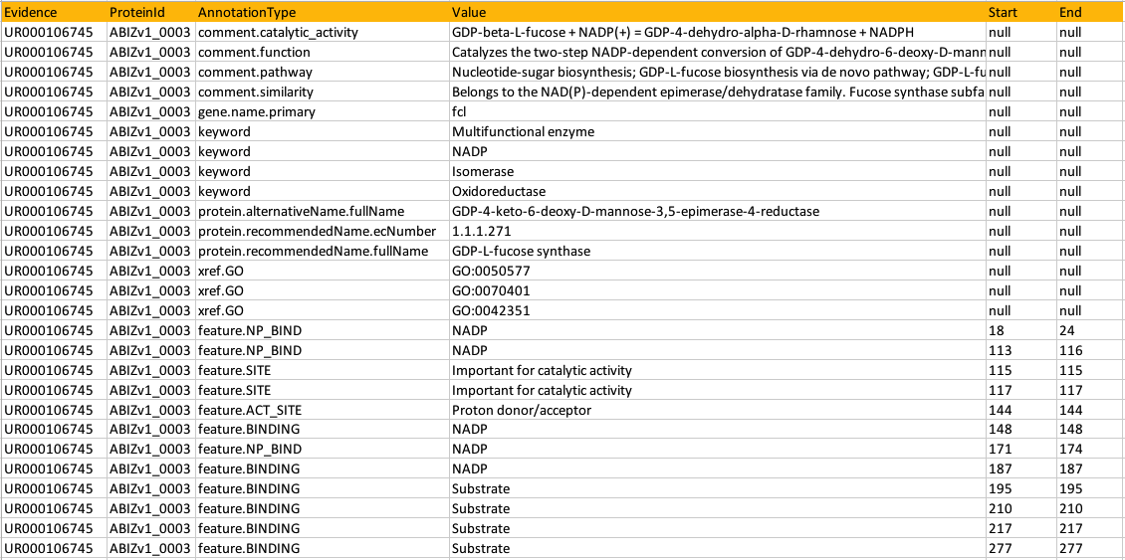
Demo – Applying UniRule rules with UniFIRE
…

Slide 29
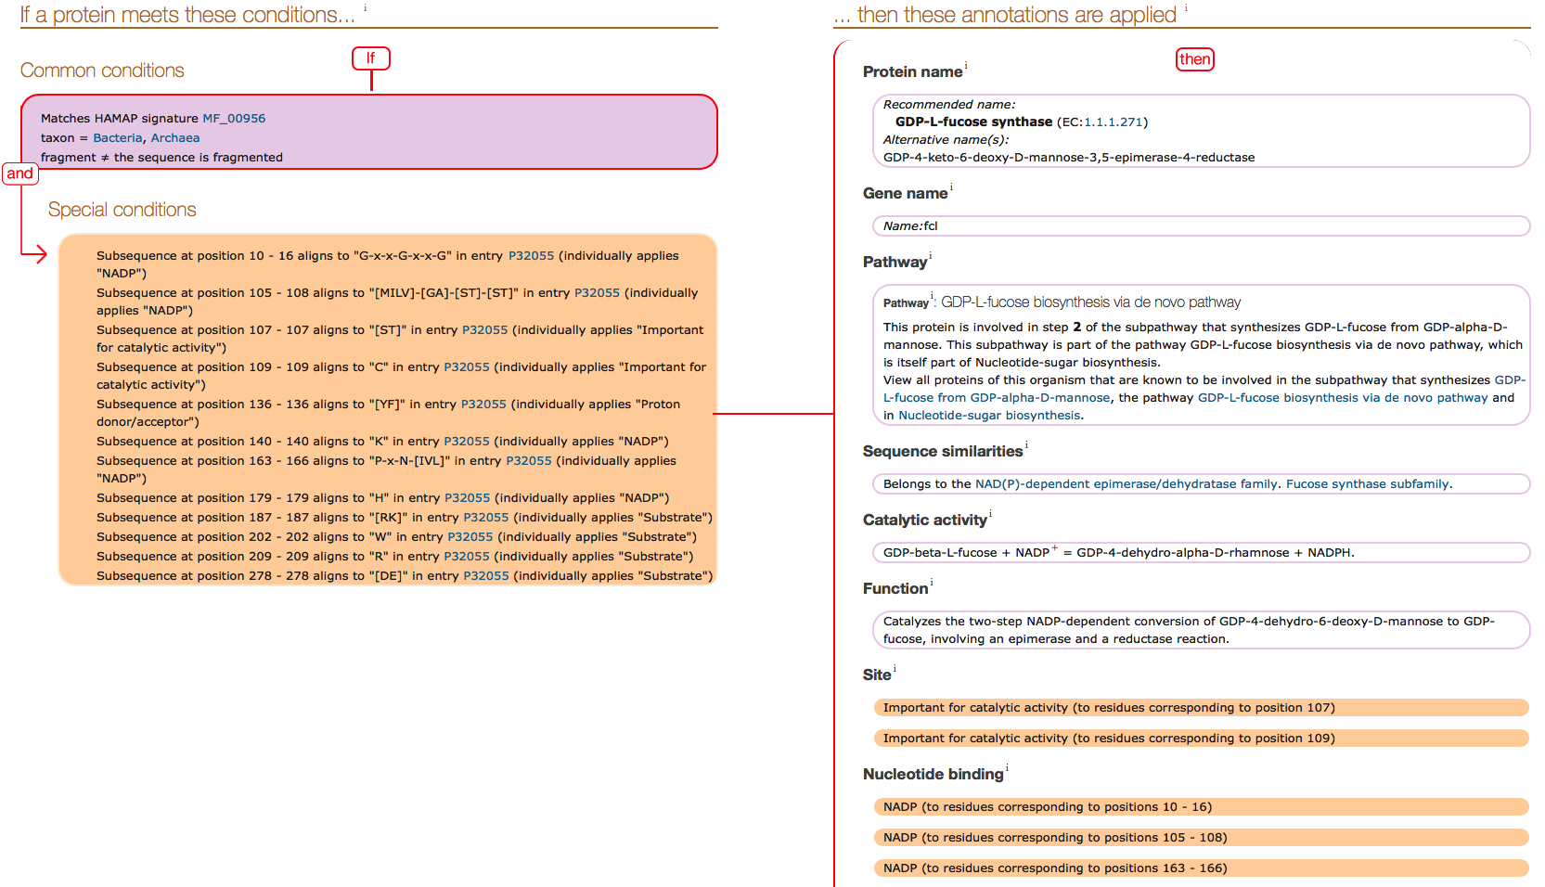
Demo – Let’s look at the triggered rule

Slide 30
Thank you for your attention, do you have any questions?

Slide 31
Questions – Breaking the ice
Any question / suggestion about:
The UniProt annotation systems?
The rule format?
The engine?
The input / output data?
How would you like to use it?
Do you have an existing annotation pipeline?
Are you running InterProScan? How?
How much data do you want to annotate?
Would you like to create annotation rules?
…

